Slide 1
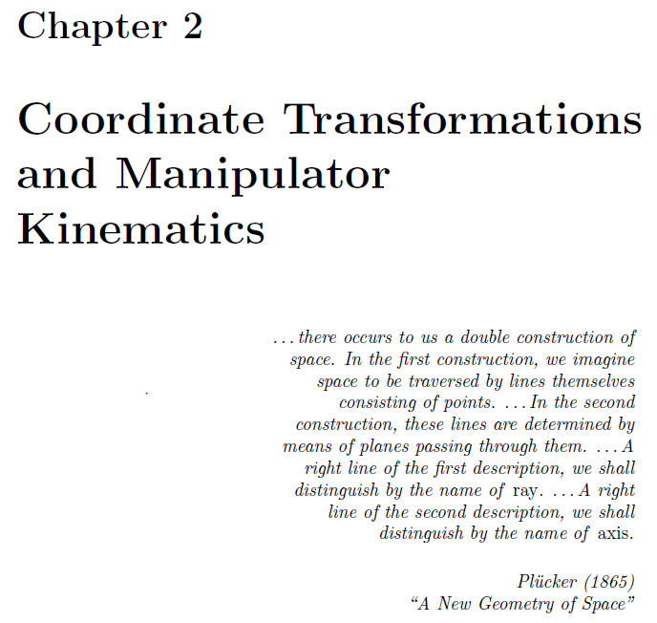

Slide 2
Objective
define the relative position and orientation of two coordinate systems
transformation of point, plane, and line coordinates
define a kinematic link of a manipulator
define standard coordinate system on each link

Slide 3
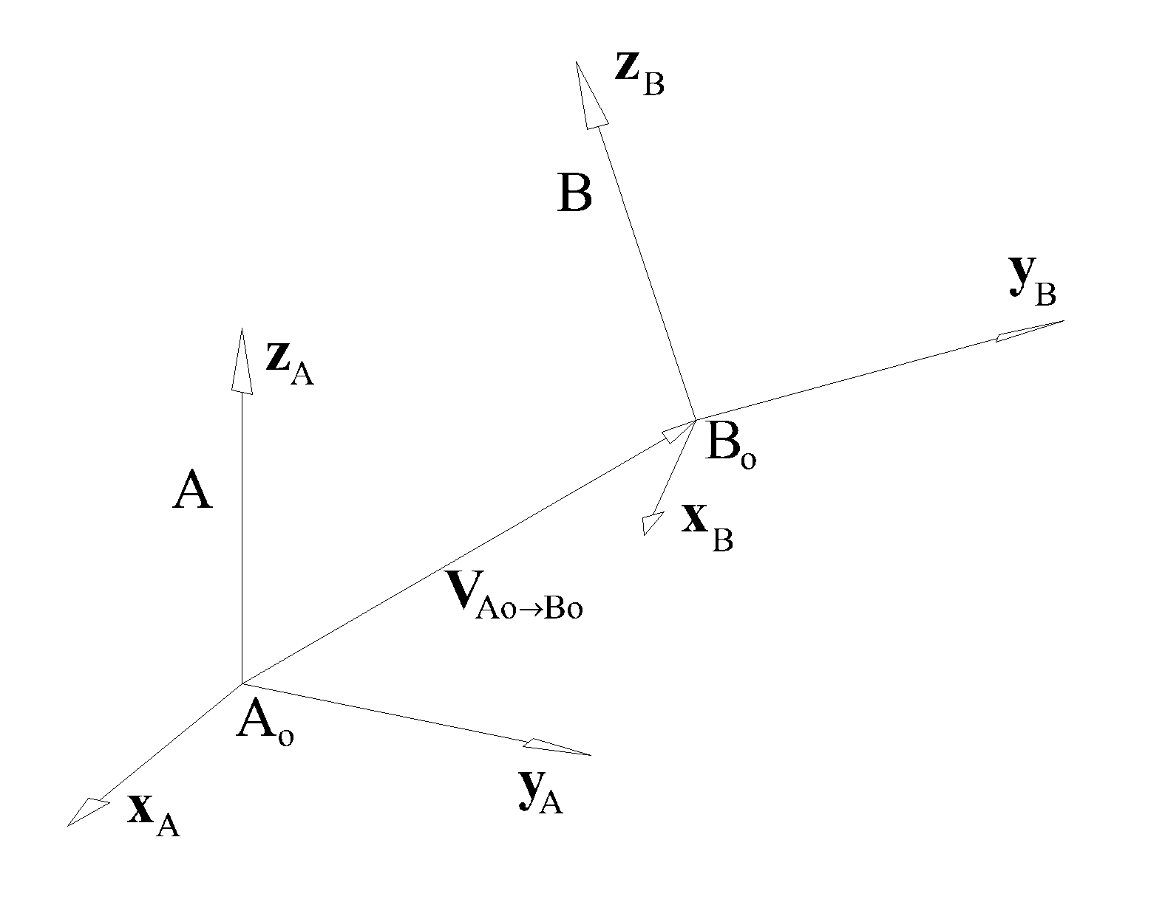


Slide 4
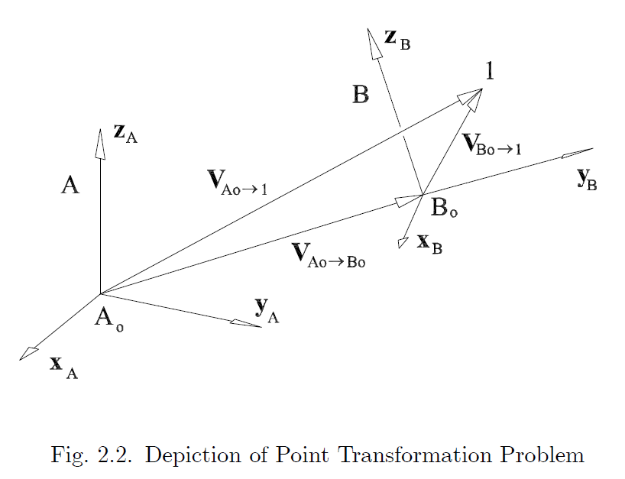
given:
find:

Slide 5
Transformation of a point.

Slide 6
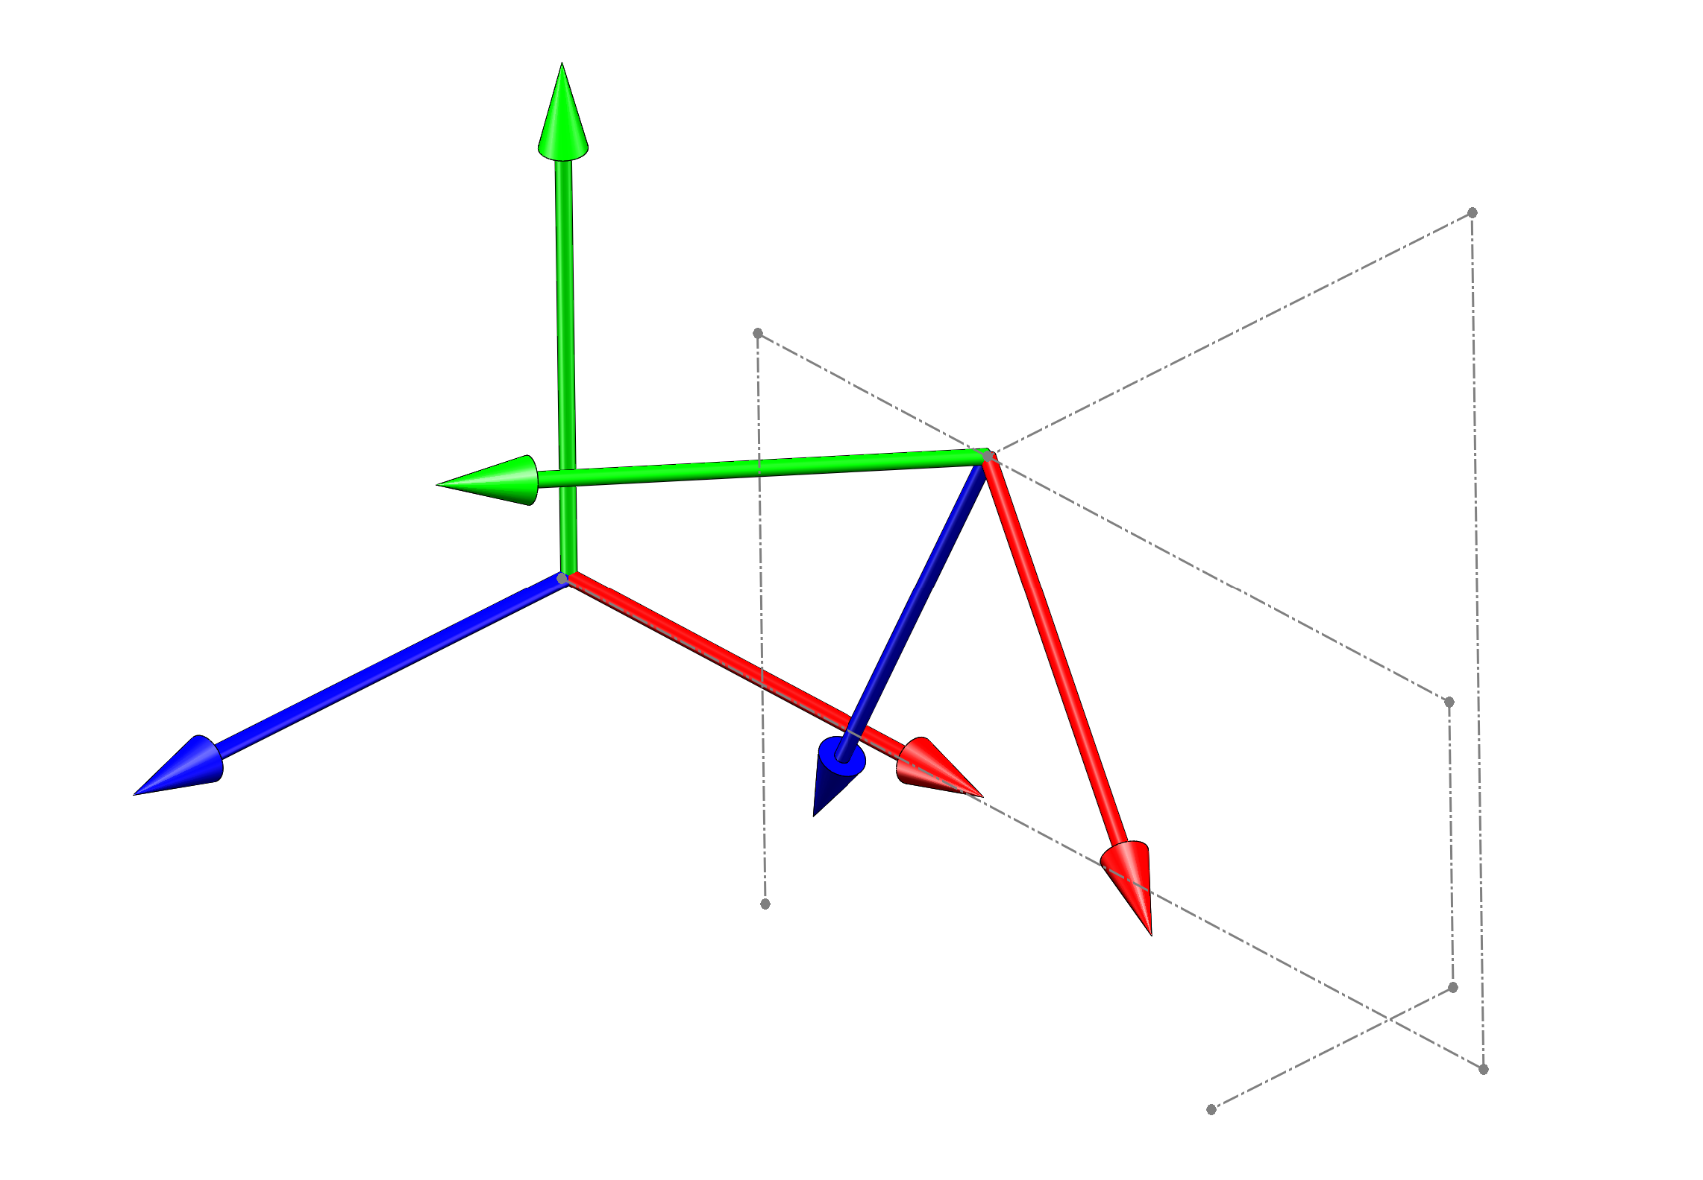
Example Problem
given:
y_{A}
2
1
y_{B}
2
2
3
z_{A}
z_{B}
x_{A}
1
4
x_{B}
1

Slide 7
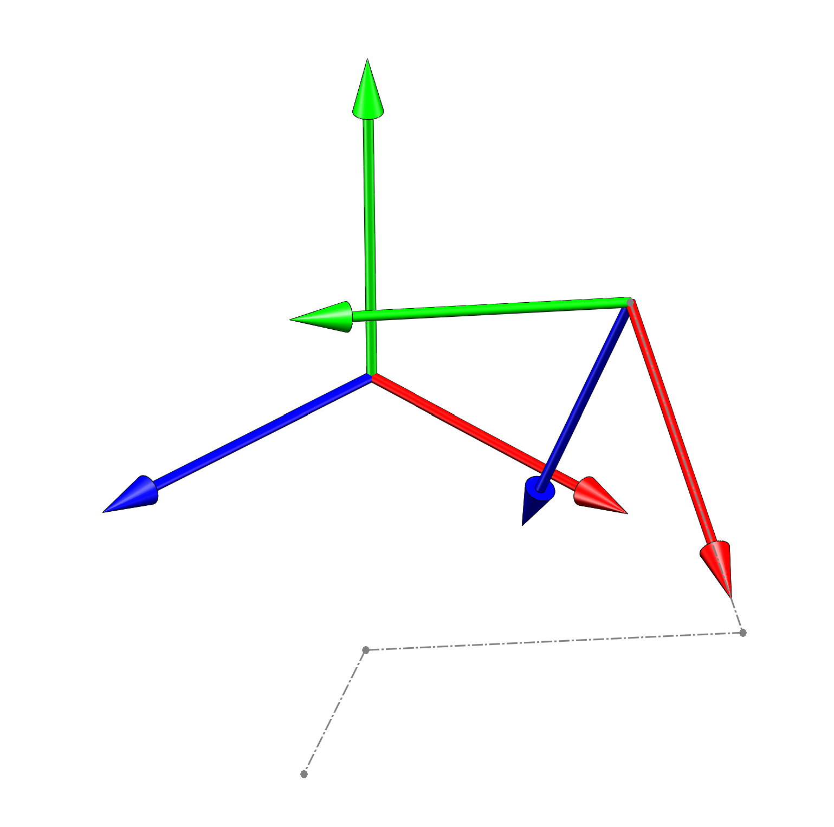
y_{A}
y_{B}
2
z_{A}
z_{B}
x_{A}
x_{B}
2
1
point 1

Slide 8
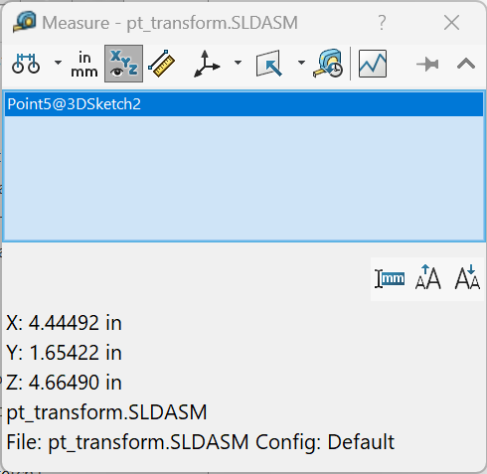
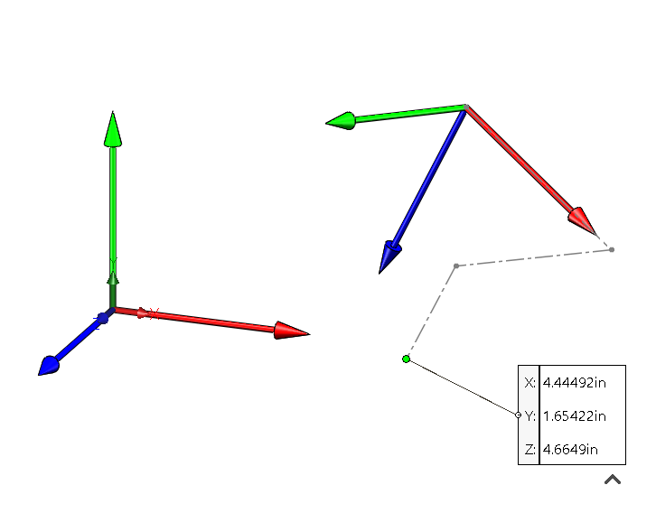

Slide 9
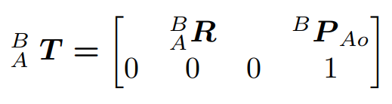
Inverse of a transformation.
given:
find:

Slide 10
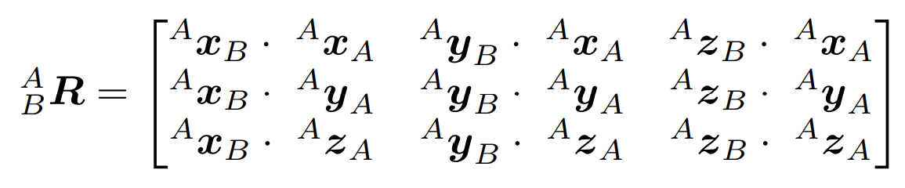
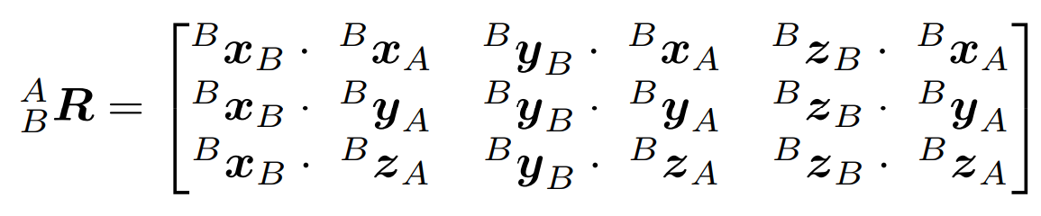
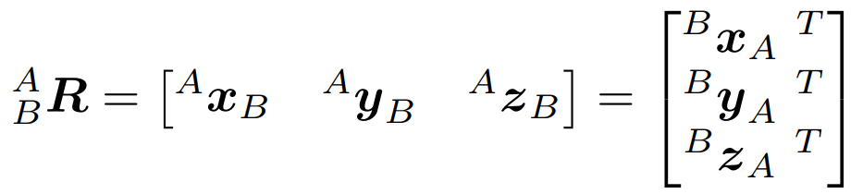
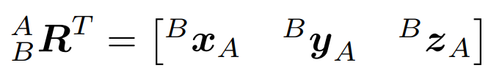
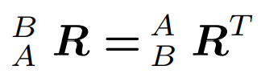
now need to get ^{B}P_{Ao}

Slide 11
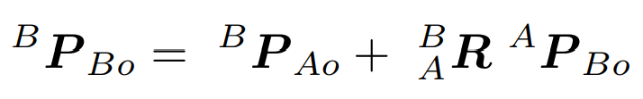
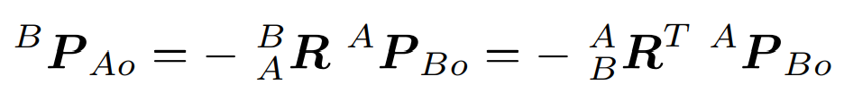
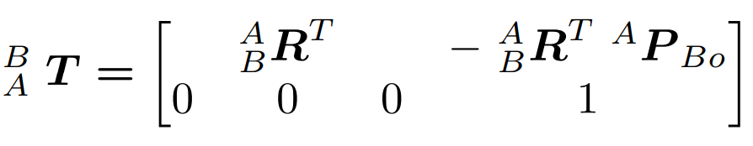
equation to transform a point from A coord sys to B

Slide 12
z_{C}
1
C
V_{C0→1}
y_{C}
C₀
V_{A0→1}
x_{C}
z_{B}
V_{B0→C0}
z_{A}
B
y_{B}
A
B₀
V_{A0→B0}
x_{B}
A₀
y_{A}
x_{A}
Figure 2.4: Compound Transformation

Slide 13
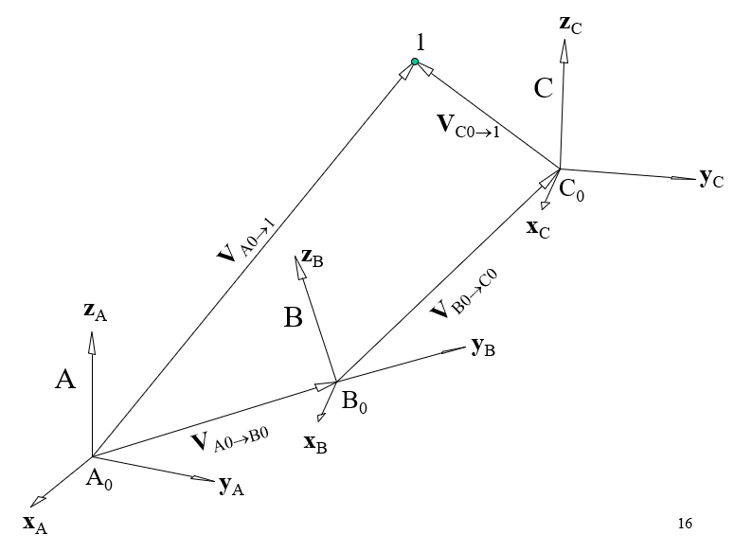
given:
find:

Slide 14
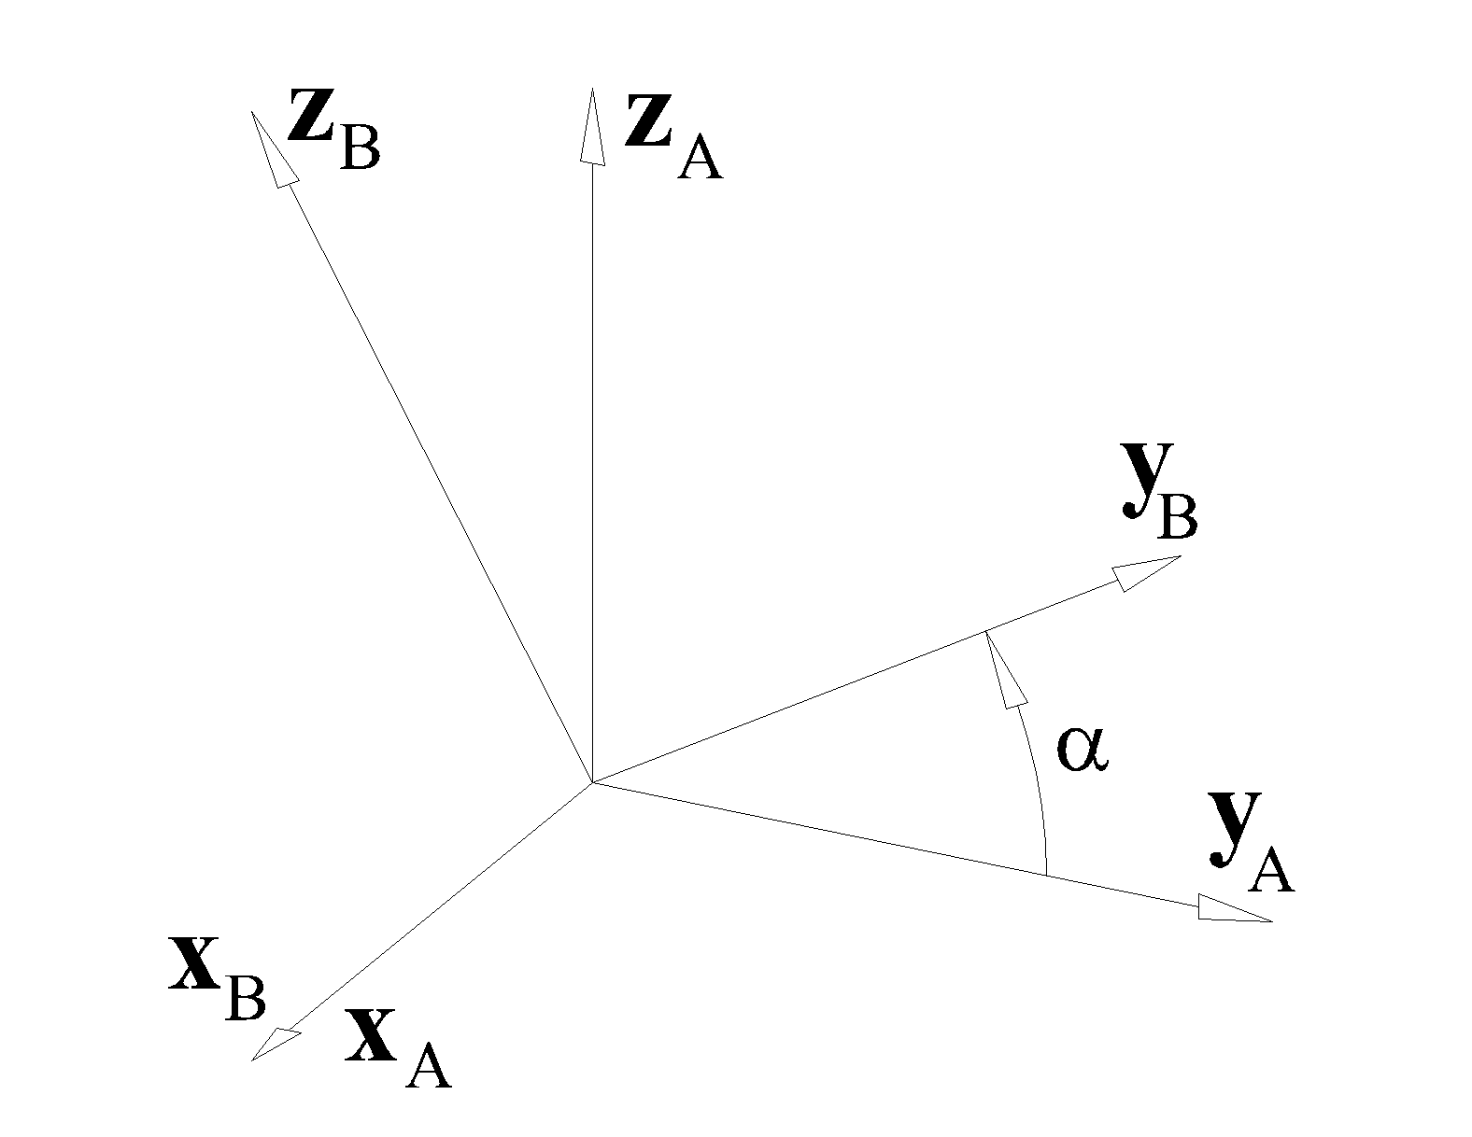

Standard transformations.

Slide 15
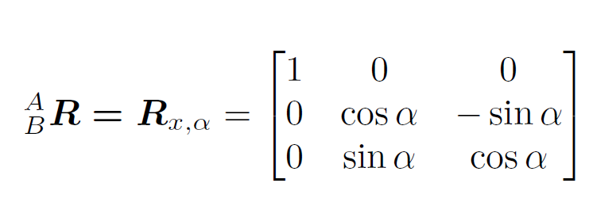
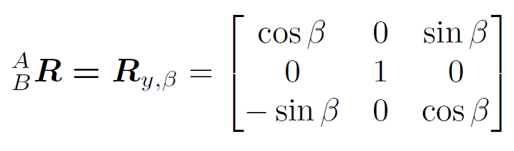
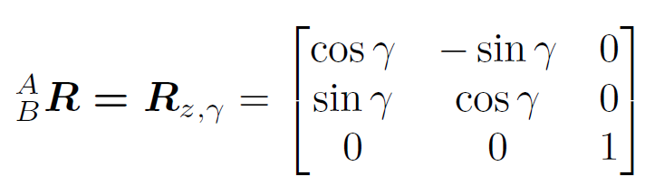
(2.27)
(2.28)
(2.29)

Slide 16
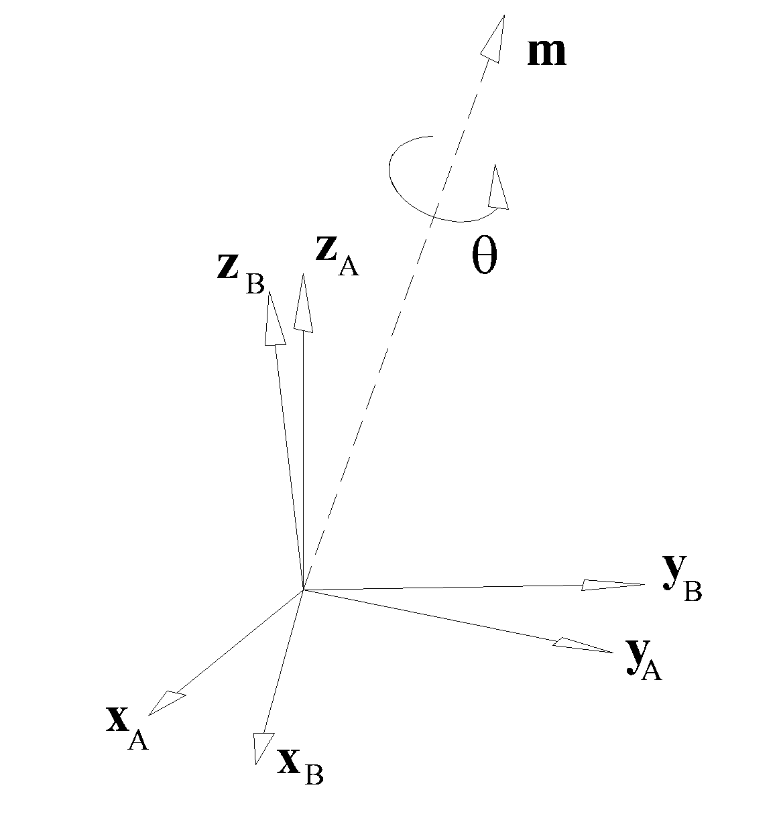
General transformation.
B is initially aligned with A.
It is rotated θ about unit vector m
find

Slide 17
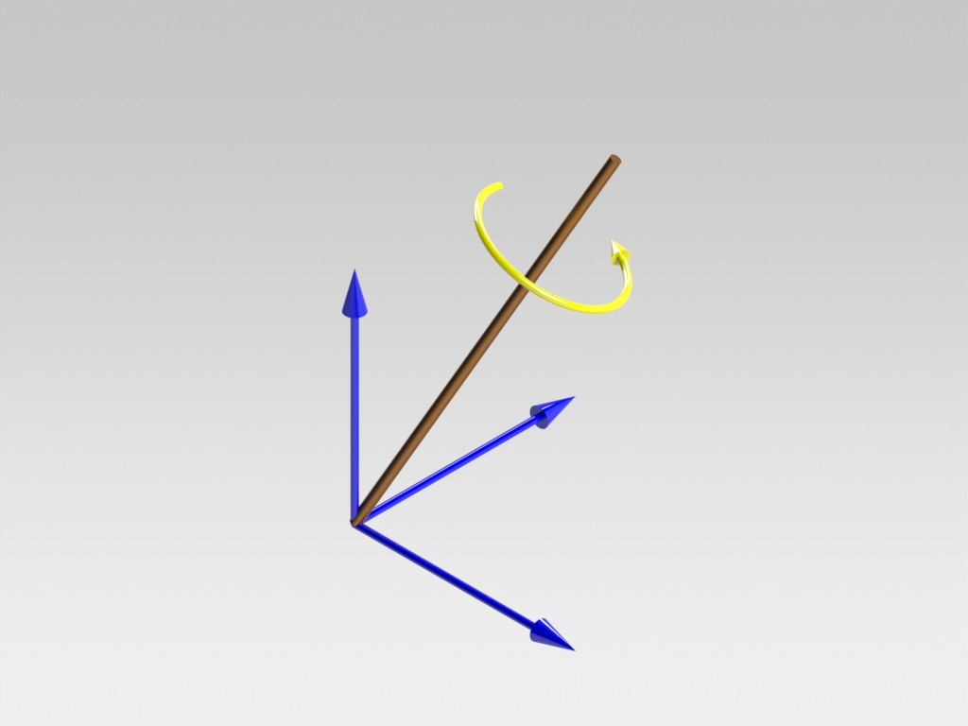
Coordinate system B is initially aligned with coordinate system A.
It is then rotated an angle θ about the axis m (unit vector).
Find .
m
z_{A}
θ
y_{A}
x_{A}

Slide 18
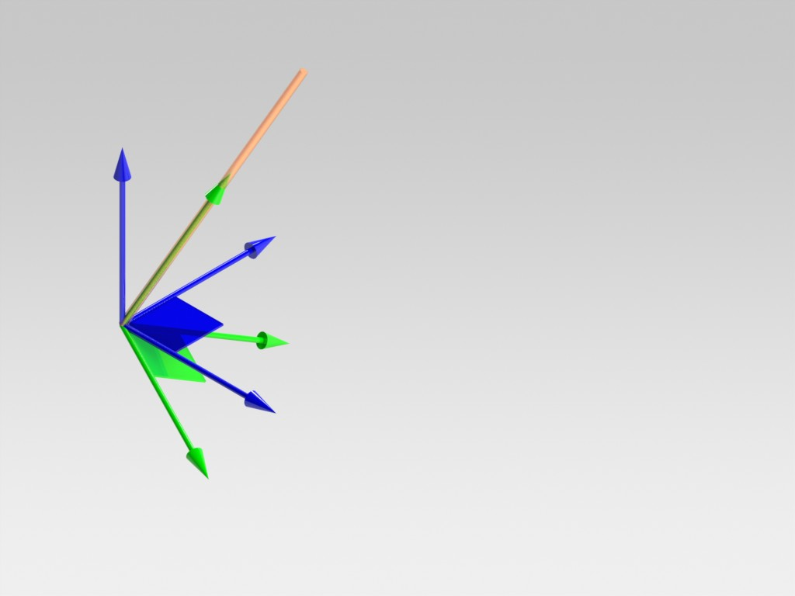
m
Coordinate system C is created such that its Z axis is along the direction of m.
z_{A}
z_{C}
y_{A}
y_{C}
x_{A}
x_{C}

Slide 19
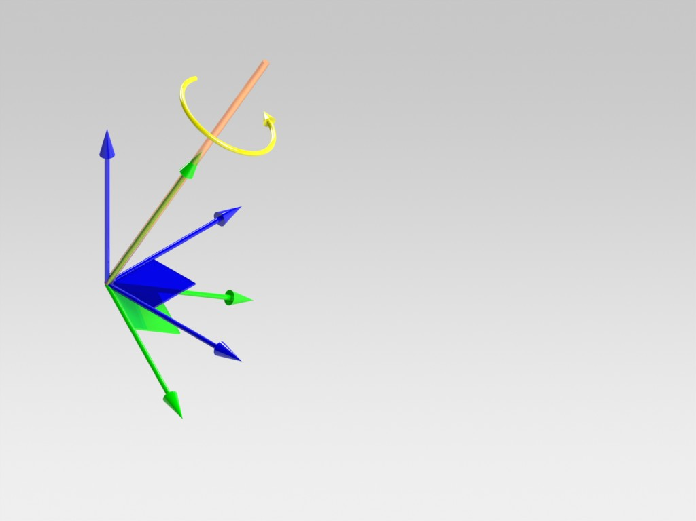
m
Coordinate systems A and C rotate together about m by the angle θ.
A rotates to become B and C rotates to become D.
The relationship between B and D must be the same as the relationship between A and C.
z_{A}
z_{C}
θ
y_{A}
y_{C}
x_{A}
x_{C}

Slide 20
m
Lastly, the rotation matrix that relates the B and A coordinate systems may be written as
z_{A}
z_{C}
θ
y_{A}
y_{C}
x_{A}
x_{C}

Slide 22
1st row is a unit vector
a_{x}² + b_{x}² + m_{x}² = 1
a_{x}² + b_{x}² = 1 - m_{x}²
1st and 2nd rows are orthogonal
a_{x}a_{y} + b_{x}b_{y}+ m_{x}m_{y} = 0
3rd column is cross product of 1st two columns
m_{z} = a_{x}b_{y} - b_{x}a_{y}

Slide 24
Opposite Problem
given:
find: m and θ

Slide 25
r₁₁ + r₂₂ + r₃₃ = (1-cosθ) (m_{x}²+m_{y}²+m_{z}²) + 3 cosθ
r₁₁ + r₂₂ + r₃₃ =1 - cosθ + 3 cosθ
r₂₁ - r₁₂ = 2 m_{z} sinθ
r₁₃ - r₃₁ = 2 m_{y} sinθ
r₃₂ - r₂₃ = 2 m_{x} sinθ

Slide 26
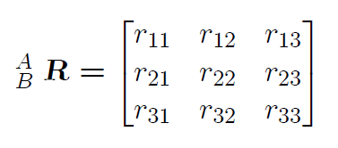
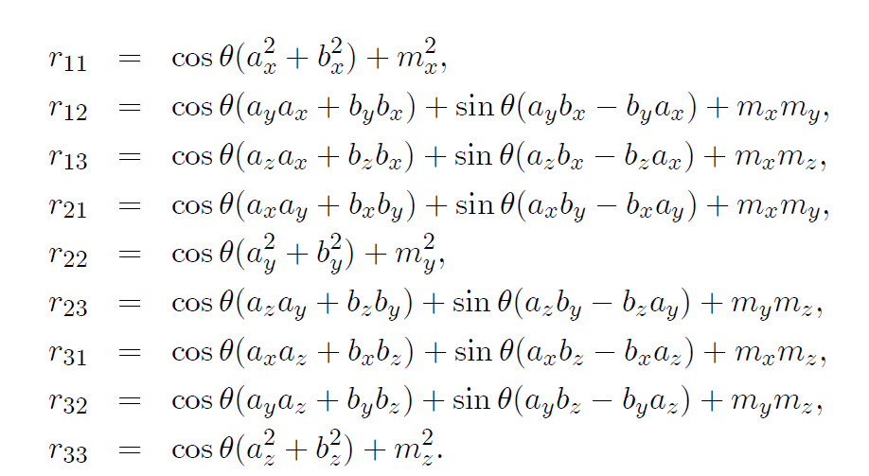

Slide 27
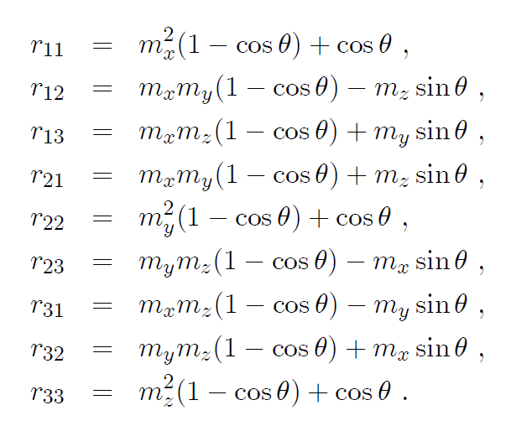

Slide 28
Transformation of a point.

Slide 29
Transformation of a point.
Transformation of a direction vector.

Slide 30
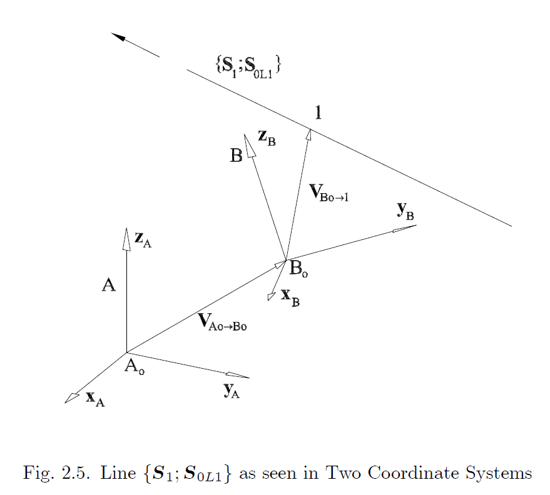
given: {^{B}S₁ ; ^{B}S_{OL1}}
find: {^{A}S₁ ; ^{A}S_{OL1}}

Slide 31
given: {^{B}S₁ ; ^{B}S_{OL1}}
find: {^{A}S₁ ; ^{A}S_{OL1}}
(2.62)
The second cross product represents the moment of the line relative to the origin point of the B coordinate system, but measured in the A coordinate system.
A moment vector is not a line-bound vector. It is only a magnitude times a direction vector.

Slide 32
given: {^{B}S₁ ; ^{B}S_{OL1}}
find: {^{A}S₁ ; ^{A}S_{OL1}}
(2.62)
The second cross product represents the moment of the line relative to the origin point of the B coordinate system, but measured in the A coordinate system.
A moment vector is not a line-bound vector. It is only a magnitude times a direction vector.
Writing the moment in the B coordinate system and then converting the direction vector to the A coordinate system gives:
(2.64)

Slide 33
given: {^{B}S₁ ; ^{B}S_{OL1}}
find: {^{A}S₁ ; ^{A}S_{OL1}}
(2.62)
(2.65)

Slide 34
Transformation of a point.
Transformation of a direction vector.
Transformation of a line.

Slide 35
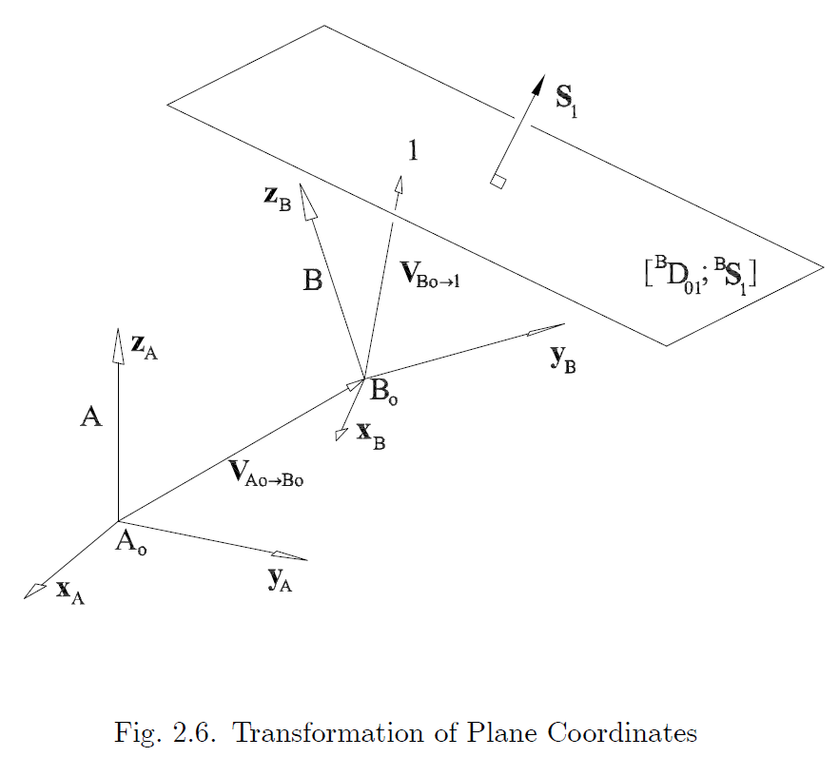
given: [^{B}D_{O1} ; ^{B}S₁]
find: [^{A}D_{O1} ; ^{A}S₁]

Slide 36
given: [^{B}D_{O1} ; ^{B}S₁]
find: [^{A}D_{O1} ; ^{A}S₁]
(2.70)

Slide 37
given: [^{B}D_{O1} ; ^{B}S₁]
find: [^{A}D_{O1} ; ^{A}S₁]
(2.70)
The scalar product is invariant with respect to the coordinate system. Thus:
(2.74)

Slide 38
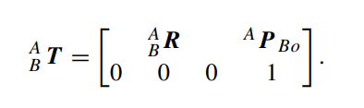
Transformation of a point.
Transformation of a direction vector.
Transformation of a line.
Transformation of a plane.

Slide 39
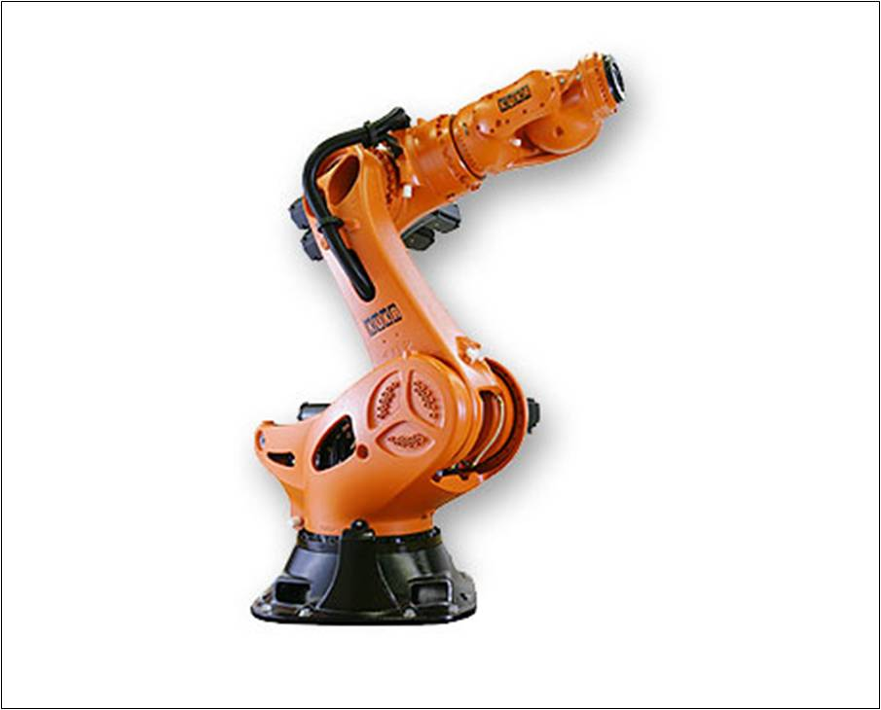

Slide 40
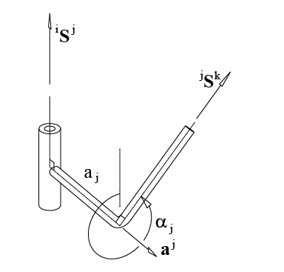


Slide 41
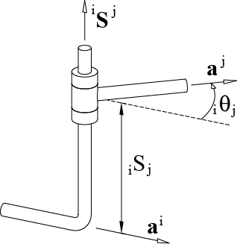


Slide 42
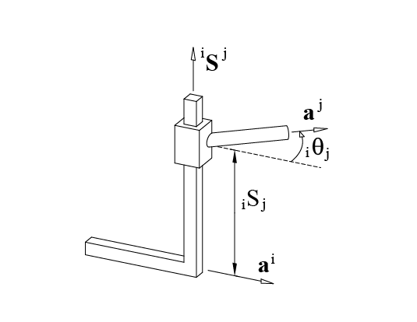


Slide 43
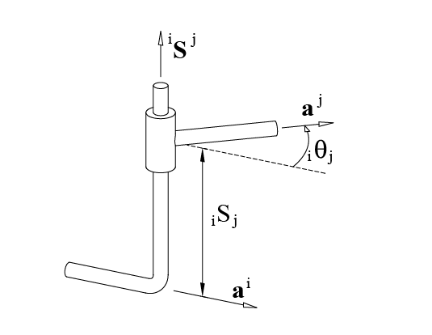


Slide 44
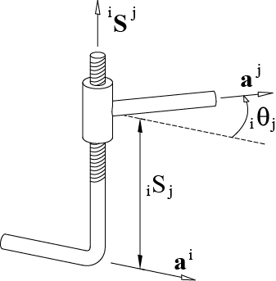


Slide 45
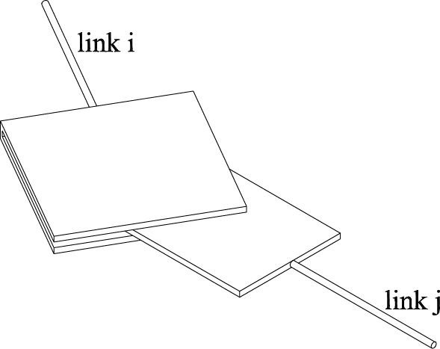


Slide 46
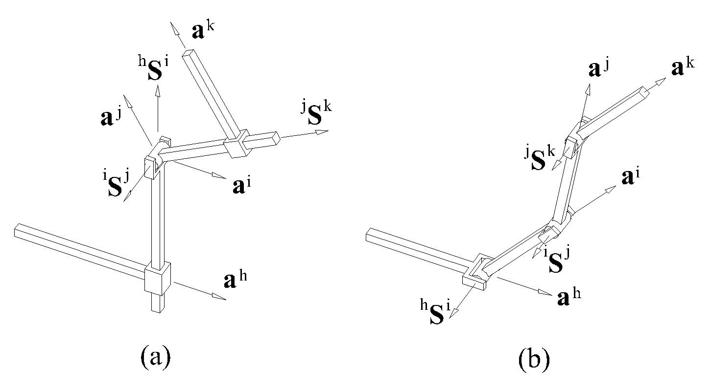

Slide 47
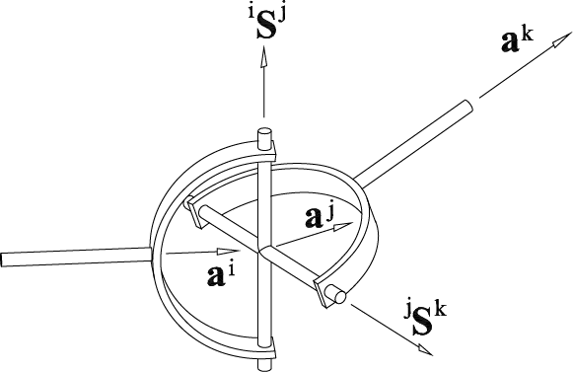


Slide 48
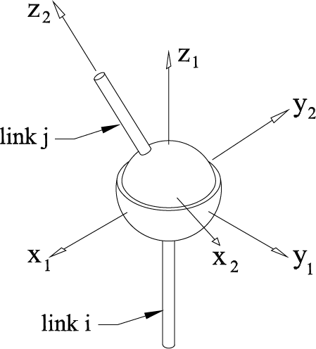


Slide 49
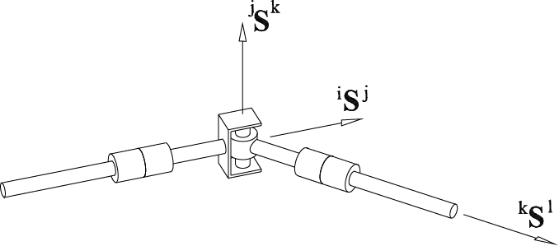

Slide 50
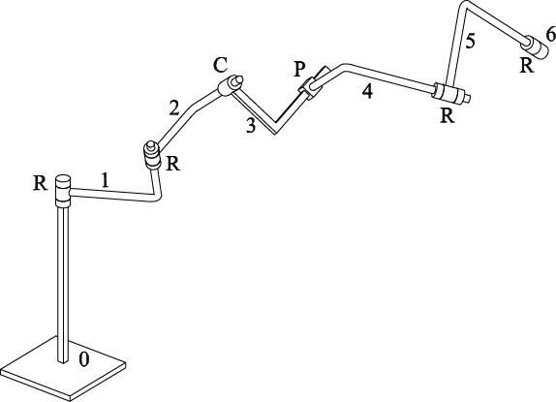


Slide 51
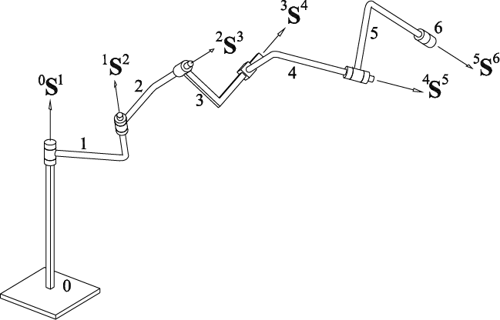


Slide 52
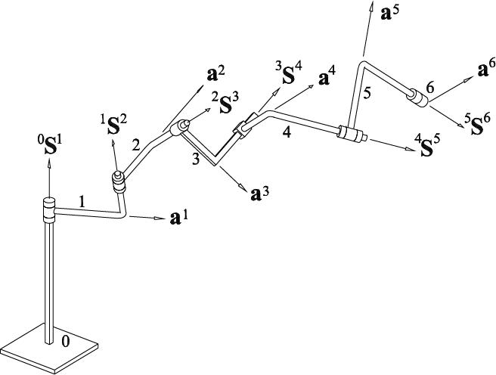


Slide 53
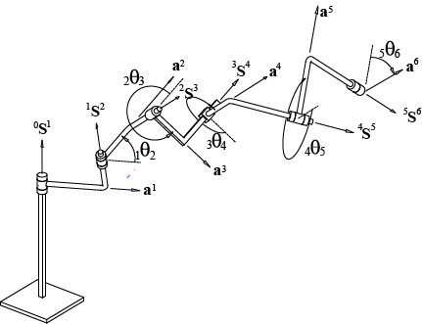


Slide 54
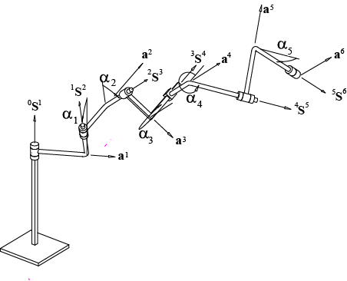


Slide 55
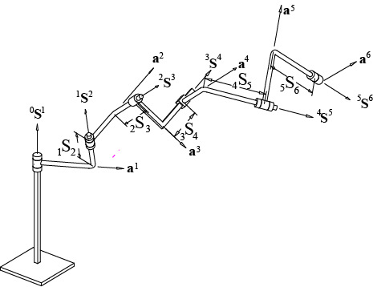

Slide 56
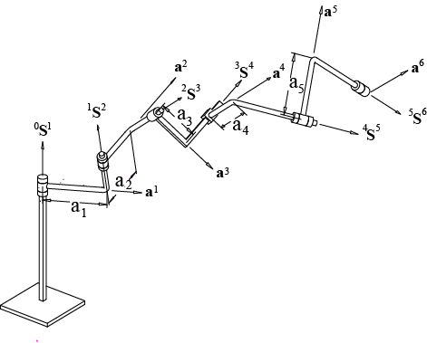


Slide 57
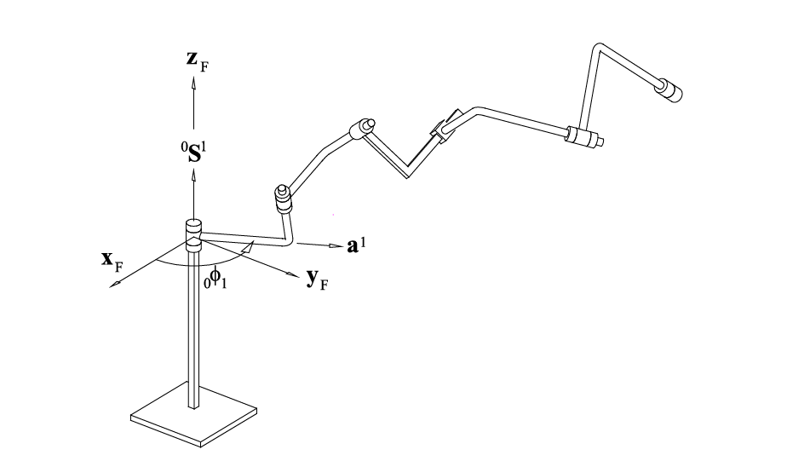

Slide 58
link lengths, a_{j}, L | twist angles, α_{j}, radians | joint offsets, _{i}S_{j}, L | joint angles, radians
a₁ = nnn | α₁ = nnn |  | ₀φ₁ = vvv
a₂ = nnn | α₃ = nnn | ₁S₂ = nnn | ₁θ₂ = vvv
a₃ =nnn | α₃ = nnn | ₂S₃ = vvv | ₂θ₃ = vvv
a₄ =nnn | α₄ = nnn | ₃S₄ = vvv | ₃θ₄ = nnn
a₅ =nnn | α₅ = nnn | ₄S₅ = nnn | ₄θ₅ = vvv
 |  | ₅S₆ = user choice | ₅θ₆ = vvv

Slide 59


Slide 60


Slide 61



Slide 62


Slide 63
3
2
4
1
5
6
0

Slide 64
⁰S¹
²S³
¹S²
3
⁴S⁵
2
4
1
5
6
³S⁴
0
⁵S⁶
Figure 3.29: Joint Vectors Labeled

Slide 65
a³
⁰S¹
²S³
a²
¹S²
a¹
3
⁴S⁵
2
a⁴
4
1
5
a⁵
6
³S⁴
0
a⁶
⁵S⁶
₅S₆ was chosen as 4”
Figure 3.30: Link Vectors Labeled

Slide 66
Table 3.2: Puma Mechanism Parameters
Link Length, in. | Twist Angle, deg. | Joint Offset, in. | Joint Angle, deg.
a₁ = 0 | α₁ = 90 |  | ₀φ₁ = variable
a₂ = 17 | α₂ = 0 | ₁S₂ = 5.9 | ₁θ₂ = variable
a₃ = 0.8 | α₃ = 270 | ₂S₃ = 0 | ₂θ₃ = variable
a₄ = 0 | α₄ = 90 | ₃S₄ = 17 | ₃θ₄ = variable
a₅ = 0 | α₅ = 90 | ₄S₅ = 0 | ₄θ₅ = variable
 |  |  | ₅θ₆ = variable
₅S₆ is actually a free choice

Slide 67
Suppose for Puma robot you were given:
constant mechanism parameters
a₁→a₅, α₁→α₅ , ₁S₂→ ₄S₅
₅S₆ and you have etched a line for a⁶ onto body 6
fixed coordinate system defined with origin at intersection of a¹ line and ⁰S¹ line
all the variable joint angles ₀φ₁ → ₅θ₆
Could you calculate:
the coordinates of all the joint axis lines in the fixed coordinate system

